Slide 1
Electrical Troubleshooting Introduction and Safety for Technicians
Electrical Troubleshooting by Ken Dickson-Self is licensed under a Creative Commons Attribution-ShareAlike 4.0 International License. Permissions beyond the scope of this license may be available at Linn Benton Community College.

Slide 2
What is Electricity?
To understand electricity, you need to understand matter
  Occupies space and has weight (solid, liquid, gas, plasma)
To understand matter, it helps to understand elements
  Building blocks of all matter
  Can’t be broken into a simpler substance
To define elements, we need to understand atoms
  (the smallest piece of an element)

Slide 3
What is Electricity?
The atom
  Nucleus – Center of the atom
  Protons – Positively charged particles inside nucleus
  Neutrons – Uncharged particles in nucleus
  Electrons – Negatively charged particles that orbit the nucleus
  Atomic number (P) & atomic weight (P+N)
  Shells – Concentric circles around the nucleus
    Valence shell – outermost shell
    Valence – number of electrons in valence shell

Slide 4
What is Electricity?
Conductors (3 or fewer valence electrons)
  Materials that contain a large number of free electronics
  (silver, copper, gold, aluminum, tungsten, iron, etc.)
Insulators (5 or more valence electrons)
  Prevents the flow of electricity
  (Mica, glass, Teflon, paper, rubber, oil, air)
Semiconductor
  Can operate as either conductor or insulator

Slide 5
Current
Current (I) – Movement of electrons (from negatively charges atoms to positively charged)
  Coulomb (C) – 6.24 x 10¹⁸ electrons
  Ampere (A) – One coulomb per second
Current that travels in one direction only is called?
Current that reverses direction at regular intervals?

Slide 6
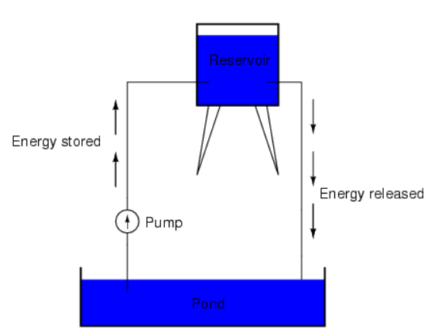
Electromotive Force
Potential – The ability of a source
to do (electrical) work
Difference of Potential
  Causes electrons to move (flow) in
  an electrical circuit
  Referred to as Electromotive Force
  EMF = Voltage (E)
  A difference in electrical potential (polarity) is required for current to flow
Image created by Ken Dickson-Self. CC BY-SA 4.0

Slide 7
Voltage
The force that moves electrons
through a circuit
Circuit must contain: Source, Pathway, Load
The pressure to move electrons
Unit of measure is the volt
Represented by E or V

Slide 8
Resistance
Opposition to current flow
Measured in Ohms
Represented by Greek letter Omega (Ω)
What sort of things have resistance?
What sort of items have low resistance? High resistance?

Slide 9
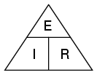
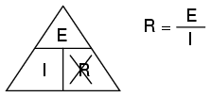
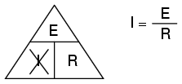
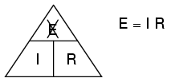
They’re related?
You can remove the value you want to learn and the picture shows you the formula to calculate your answer:
So, if I have a resistor of 48Ω and measure current of 0.50A, what’s the voltage?
What current should I expect in a 12V system with a 36Ω resistor?
What’s the resistance in a 5 volt circuit when I’m measuring current of 0.02A?
Images: DC Circuits – Vol I. by Tony Kuphaldt via allaboutcircuits.com, used under the Direct Science License.

Slide 10
They’re related?
If resistance stays constant, when voltage increases then current ______________.
If voltage stays constant, when resistance drops then current _______________.
If current stays constant, when voltage increases then resistance ______________.
Images: DC Circuits – Vol I. by Tony Kuphaldt via allaboutcircuits.com, used under the Direct Science License.

Slide 11
Electrical safety
Treat all circuits as if they were live.
Think about the job before starting to work.
(Plan the job with safety in mind.)
Do not work live unless absolutely necessary.
Before working on the de-energized circuit test it with your meter to be sure it is not energized and operate all controls.
Do not wear rings, neckties, watches, bracelets/jewelry, necklaces, or key chains.
Stove repair skills

Slide 12
How to save time…?
This meter had the original fuse replaced with an automotive fuse. When the operator attempted to measure 480 volts with the leads in the current inputs, the fuse offered no protection. It is better to leave the circuit unfused and open than to use the wrong fuse.
Note that the test leads and probes, though damaged, survived more or less intact. This fact, plus the mechanical ruggedness of the meter body, which helped to contain the explosion, contributed to the fact that the operator was not hurt.

Slide 13
Electrical safety
Wear thick rubber soled boots.
If you must work hot, work one handed when possible. Always use insulated pads, maybe insulated gloves (always on higher voltages).
High voltage > 600V use all high voltage gear, special probes, special meter, insulating gloves and pads (special training).
Work with a partner.
Let people know where you are working
Racking Breakers

Slide 14
Wrong Meter Used On Circuit
An electrician was loaned this low-cost meter one day because his quality meter was not available. He accidentally went across 480 volts with the leads in the amps jacks. Both fuses are 250 volts. The fuse didn’t open in time to prevent major damage to the meter. However, while the meter is not as dramatically damaged as the previous ones, the electrician was injured - he had severe burns on his forearm, upper arm and shoulder and had his arm in a sling when we met him. A good part of the reason is the cheap quality of the probes and leads.

Slide 15
Electrical safety
Use wood or fiberglass ladders.
Use the right tool for the job.
Maintain your tools. Arc Flash/Blast
Ground all power tools.
Remember even low voltage kills, by causing the heart muscles to stop or beat irregularly (ventricular fibrillation) and damaging the brain.
Use a fuse puller to remove a fuse, break contact with supply side first. When replacing a fuse put it into the load side first then the line side.

Slide 16
Aftermath Of Accident
Shot of inside of disconnect enclosure where fireball occurred. Note that the damage occurred on the line side of the fuses. The load side is virtually undamaged. This shows a critical mistake that was made - measuring on the line instead of the load side of a circuit protective device. You should always look for the lowest energy point to make the measurement.

Slide 17
Electrical safety
Donnie Johnson's Accident
Donnie's Story
Eddie Adams
Notes:
I use these videos to impress on students the seriousness of safety in our fiedl. In our program, students start their troubleshooting on high (208 and 460) voltage (3-phase). Once they’ve become familiar with that, we step down to 120VAC. Only after several terms do they begin working with DC and lower voltage electronics.
(I’m not saying this is the best way to teach it, but this is how we do it). LOTO is covered under a co-requisite (Industrial Safety) course.

Slide 18
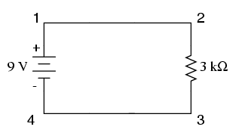
Series
E = ___
I = ___
R = ___
Source, Pathway, Load
Images: DC Circuits – Vol I. by Tony Kuphaldt via allaboutcircuits.com, used under the Direct Science License.

Slide 19
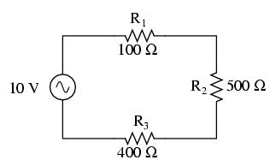
Series
E = ___
I = ___
R = ___
E_{Total} = E₁ + E₂ + E_{3…}
I_{Total} = I₁ = I₂ = I_{3…}
R_{Total} = R₁ + R₂ + R_{3…}
 | R1 | R2 | R3 | Total
E |  |  |  | 10 V
I
R | 100 | 500 | 400
Images: DC Circuits – Vol I. by Tony Kuphaldt via allaboutcircuits.com, used under the Direct Science License.
Notes:
This table is filled out together in class and have been left with blanks on purpose.

Slide 20
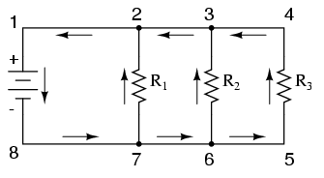

Parallel
E_{Total} = E1 = E2 = E3…
I_{Total} = I₁ + I₂ + I_{3…}
__1__ = __1__ + __1__ + __1__
R_{Total} R₁ R₂ R_{3…}
 | R1 | R2 | R3 | Total
E |  |  |  | 10V
I
R | 100 | 500 | 400
Images: DC Circuits – Vol I. by Tony Kuphaldt via allaboutcircuits.com, used under the Direct Science License.

Slide 21
Scientific Notation

