Slide 1
The Final Stretch!
Electrical Troubleshooting by Ken Dickson-Self is licensed under a Creative Commons Attribution-ShareAlike 4.0 International License. Permissions beyond the scope of this license may be available at Linn Benton Community College.

Slide 2
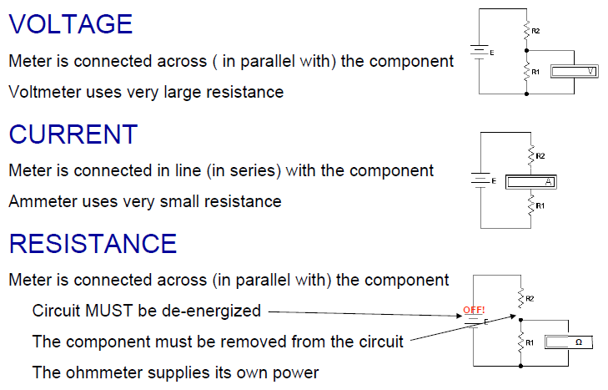
Measuring Voltage, Current and Resistance (Replay)

Slide 3
Current and Ampacity

Slide 4
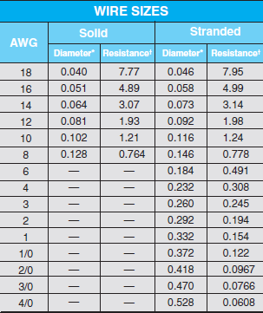
Current and Ampacity
Current – Flow of electrons through a conductor
Ampacity – Amount of current a conductor or wire can carry safely
NEC Wire Ampacity
Gauge | Ampacity | Fuse
14 | 20A | 15A
12 | 25A | 20A
10 | 35A | 30A

Slide 5
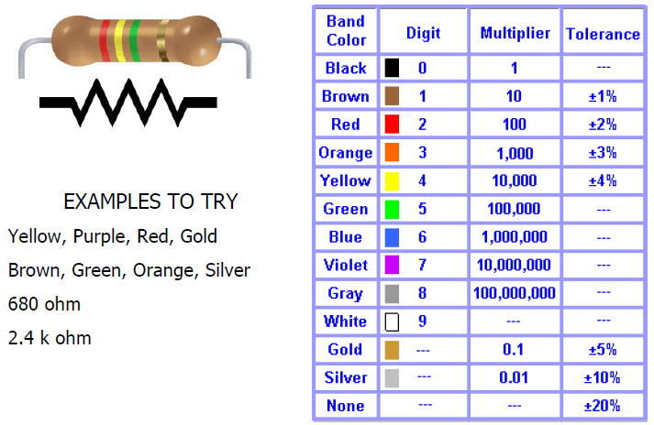
Resistors

Slide 6
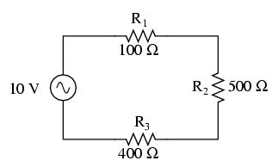
Series
E = ___
I = ___
R = ___
E_{Total} = E₁ + E₂ + E_{3…}
I_{Total} = I₁ = I₂ = I_{3…}
R_{Total} = R₁ + R₂ + R_{3…}
 | R1 | R2 | R3 | Total
E |  |  |  | 10 V
I
R | 100 | 500 | 400

Slide 7
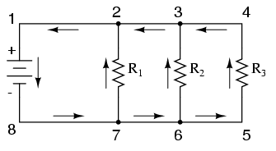

Parallel
E_{Total} = E1 = E2 = E3…
I_{Total} = I₁ + I₂ + I_{3…}
__1__ = __1__ + __1__ + __1__
R_{Total} R₁ R₂ R_{3…}
 | R1 | R2 | R3 | Total
E |  |  |  | 120V
I
R | 10 | 50 | 40

Slide 8
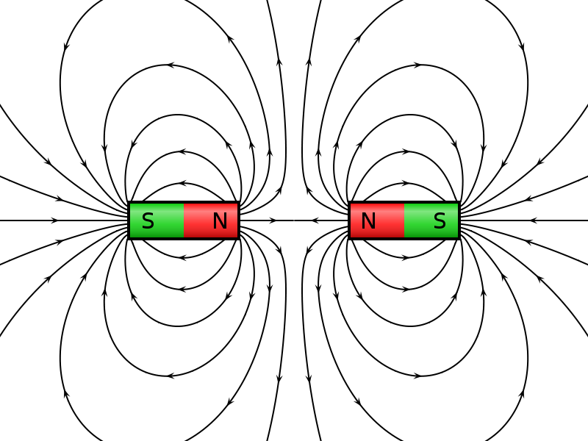
MAGNETISM
Image: VFPt cylindrical magnets repelling.svg by Geek3, via Wikimedia is used under CC BY-SA 3.0.

Slide 9
Law of Charges
LIKE charges REPEL
UNLIKE charges ATTRACT

Slide 10
Magnetism
When lightning strikes, nearby magnetic compass needles jerk in response to the electrical discharge. No compass needle deflection results during the accumulation of electrostatic charge (voltage) preceding the lightning bolt, but only when the bolt actually strikes. What does this phenomenon indicate about voltage, current, and magnetism?
The presence of an electric current will produce a magnetic field, but the mere presence of a voltage will not.
For more detail on the historical background of this scientific discovery, research the work of Hans Christian Oersted in the early 1820’s. Oersted’s work paved the way for the development of electric motors, among other useful electrical devices.

Slide 11
Magnetism

Slide 12
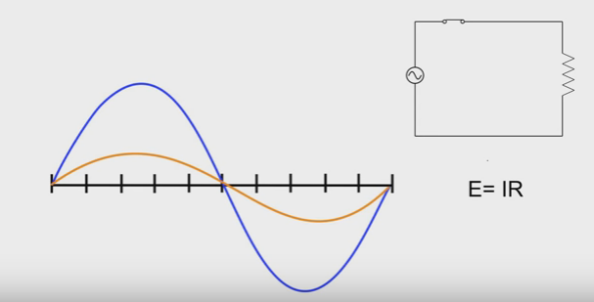
Induction
First, the purely resistive circuit
Voltage and Current are in phase
What would the power sine wave look like?

Slide 13
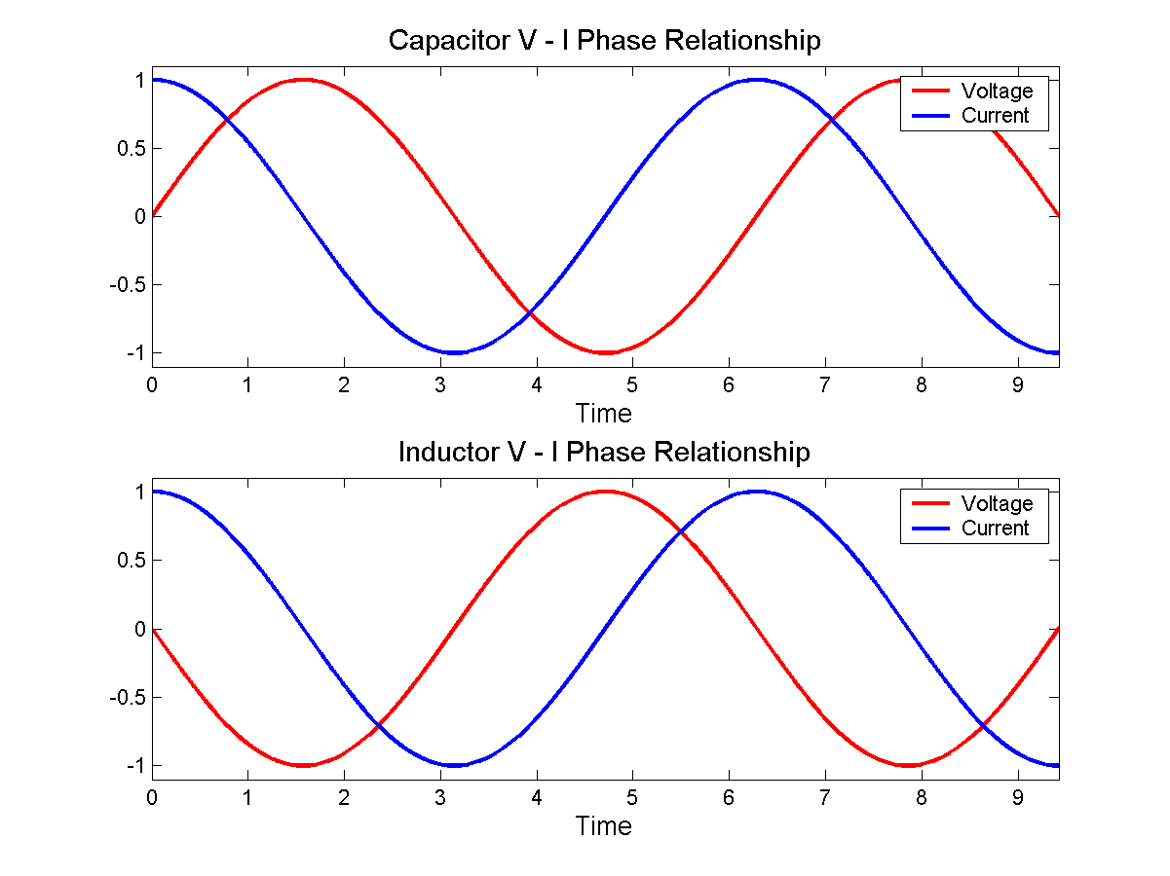
Induction
Any time we have coils of wire, we have induction
Inductance (L), is measured in unit called the henry (H)

