Slide 1
Coils, Relays and Transformers
Electrical Troubleshooting by Ken Dickson-Self is licensed under a Creative Commons Attribution-ShareAlike 4.0 International License. Permissions beyond the scope of this license may be available at Linn Benton Community College.

Slide 2
In-Class Activity

Slide 3
Testing Relays
Test activation signal
  May be able to test for activation signal by listening to the relay
  Otherwise, test coil normally
Test switch output
  same test for any other switch
  activate the relay and check that the switch functions properly
Relays – Quick Testing Tips
Replace relay with a known good relay
  Quick and effective
Remove relay and put a jumper across correct pins to simulate a closed switch
  If output circuit functions, the circuit is ok

Slide 4
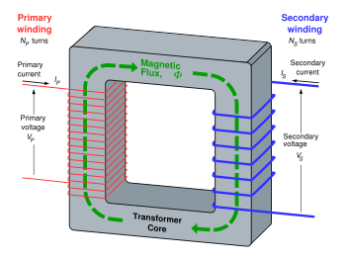
Transformer Structure
Image: “Transformer 3D” by Bill C, via Wikimedia, is used under CC BY-SA 3.0.

Slide 5
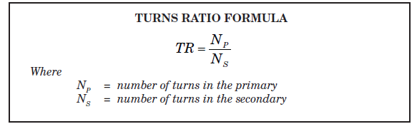
If Ns > Np then the transformer is termed “step-up”
If Np > Ns then the transformer is termed “step-down”
If Ns = Np then the transformer is termed “isolation”

Slide 6
Rs through primary coil
Rs through secondary coil
Rs primary to secondary
Rs primary to body
Rs secondary to body
(How would you test voltage?)

