Slide 1
Culture & Communication
Culture & Communication by John Drischell is licensed under a Creative Commons Attribution-ShareAlike 4.0 International License.

Slide 2
How we categorize creates expectations

Slide 3
The Importance of Curiosity
Ask Questions
Be Open Minded
Be Sensitive
Be Aware of your cultural norms
No One-Size-Fits-All

Slide 4
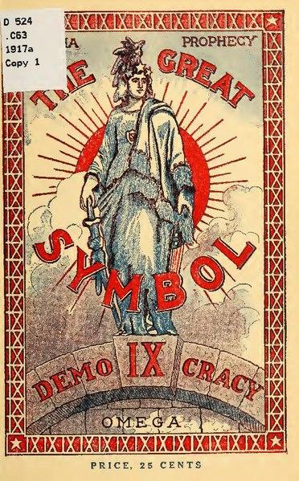
History of Culture

Slide 5
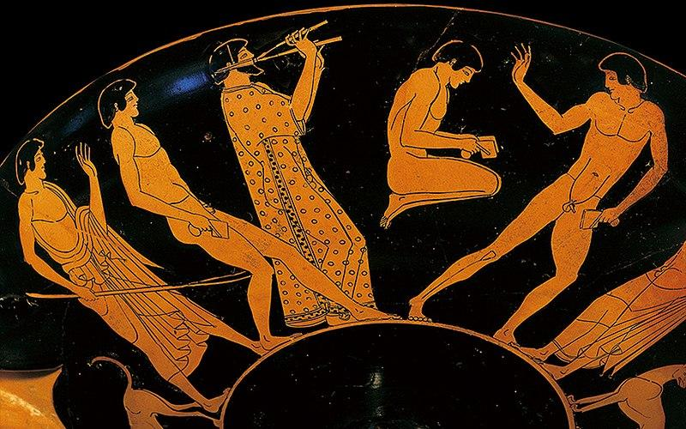
What are ways we commonly think of history?
History is one way to understand the present.

Slide 6
What are ways we commonly think of history?

Slide 7
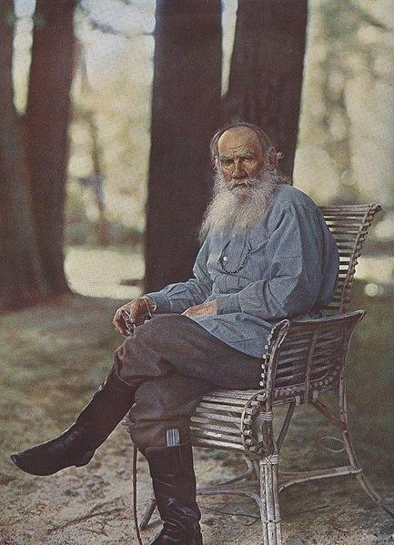
“History would be a wonderful thing - if it were only true” (Leo Tolstoy)

Slide 8
The Existential Dilemma
Is history escapable?

Slide 9
The Existential Dilemma
We cannot escape history, decisions made in the past continue to influence us today
Is history escapable?

Slide 10
The Existential Dilemma
We cannot escape history, decisions made in the past continue to influence us today
We can change the way we view the past.
Is history escapable?

Slide 11
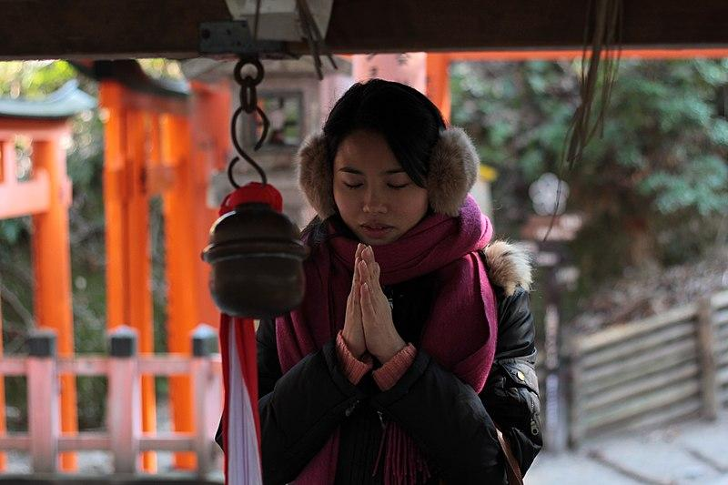
Tragedy in History
Personally
Embracing your pain and making it a part of you.

Slide 12
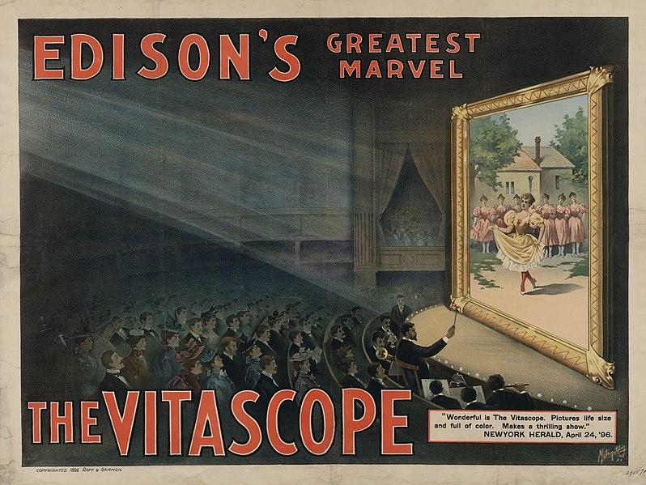
Reinvention

Slide 13
No Singularity
There is no single version of history
The past is recorded in many different ways.

Slide 14
Rewriting History in Cinema

Slide 15
No Singularity
3. U.S. History may leave out things that reflect badly on national character

Slide 16
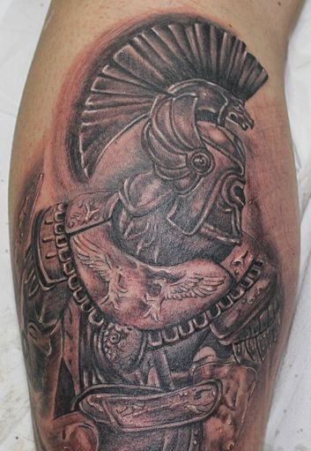
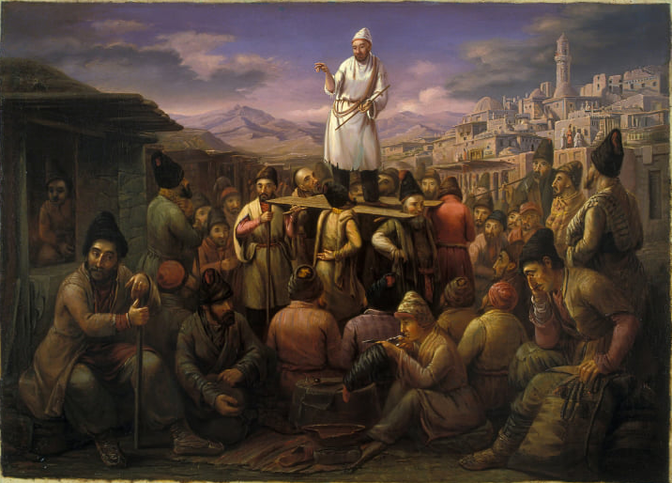
Ways we remember history
Nationally: Monuments paying homage to devastation.
Personally: Memorial tattoos that symbolize closeness and deep love.
Socially: storytelling
"Tattoo" by David Lopez Gutierrez / muayayo is licensed under CC BY-NC-SA 4.0

Slide 17
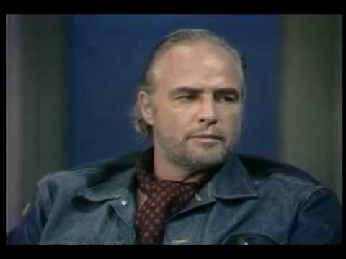
Using Star Power to Acknowledge Injustices
It was more rare in the 70s for celebrities to use their star power to project political issues that might hurt their reputation (and the U.S.)
Brando famously brought injustices to light in regards to Native Americans.
YouTube: Marlon Brando on Dick Cavett

Slide 18
Using Star Power
In 1973, Brando declined his Oscar award for best actor in The Godfather.
Sacheen Littlefeather accepted the award for him, to then boycott the Oscar ceremony to draw attention and protest against how unfairly Native Americans have been represented in film.
YouTube: Marlon Brando on Dick Cavett

Slide 19
No Singularity
4. Family history helps us understand our own cultural background.

Slide 20
Cultural Background and Identity
Cultural Background: the “preforms” of your learned behaviors & values, lending to a person's identity.

Slide 21
Cultural Background and Identity
Cultural Background: the “preforms” of your learned behaviors & values, lending to a person's identity.
Historically driven (past oriented)

Slide 22
Cultural Background and Identity
When people from different cultural backgrounds interact, those differences form hidden barriers that may not be understood right away.

Slide 23
Family Ties
Your family (may) constitute a large part of your cultural background, and hence, your history.
Traditions, language, values, behaviors, foods, holidays, etc.

Slide 24
Family Ties
Your family (may) constitute a large part of your cultural background, and hence, your history.
Traditions, language, values, behaviors, foods, holidays, etc.
(remember: culture is learned, so this (can) exclude inherent biological and physical traits)

Slide 25
Family Relation Activity
Put your name on a single sheet of paper to turn-in.
Draw a large circle. Within the circle, draw people/diagrams you consider a part of your family. Draw lines to connect members together and label the relation.
At the bottom, write down three traditions.

Slide 26
Is Family Exclusive to Blood Relation?
Do you consider your friends to be a part of your family?
Is family what you make it?

Slide 27
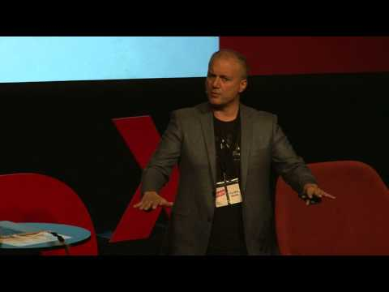
Cross - Cultural Ted Talk
Cross cultural communication | Pellegrino Riccardi | TEDxBergen

