Slide 1


Attribution 4.0 International (CC BY 4.0)

Slide 2

Attribution 4.0 International (CC BY 4.0)

Slide 3
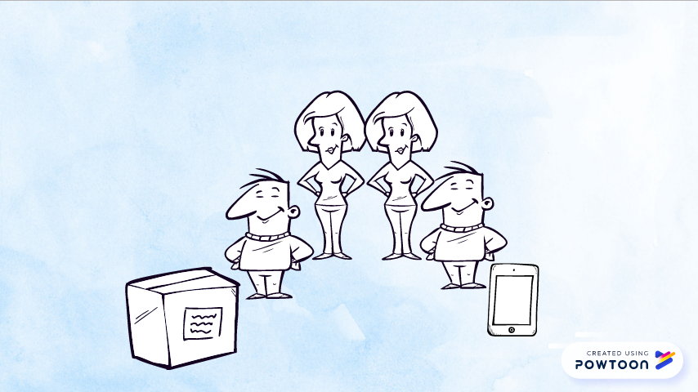
Attribution 4.0 International (CC BY 4.0)

Slide 4

Attribution 4.0 International (CC BY 4.0)

Slide 5
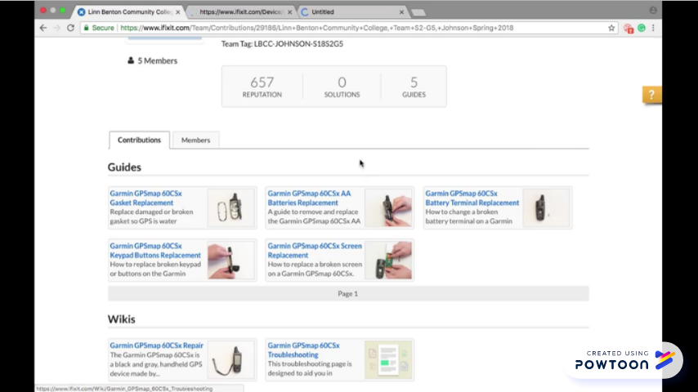
Attribution 4.0 International (CC BY 4.0)

Slide 6
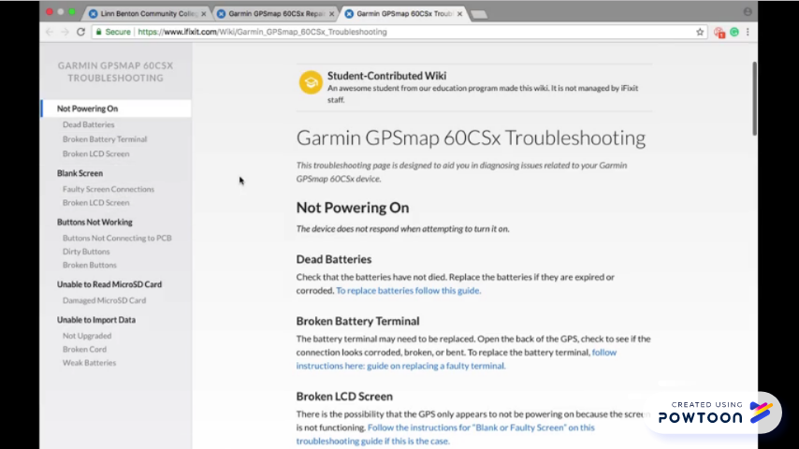
Attribution 4.0 International (CC BY 4.0)

Slide 7
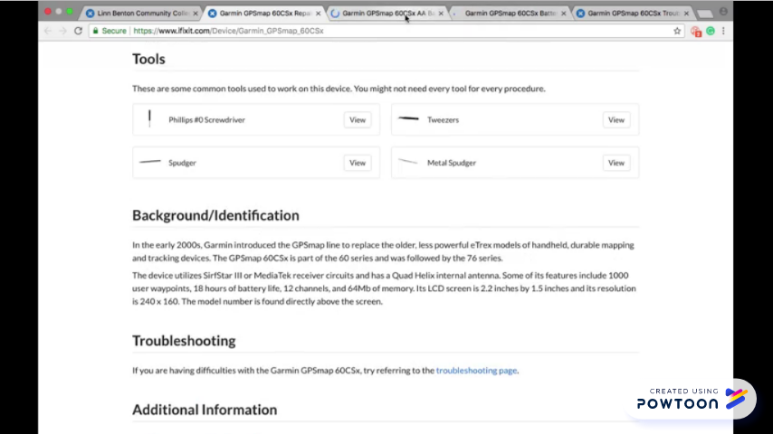
Attribution 4.0 International (CC BY 4.0)

Slide 8
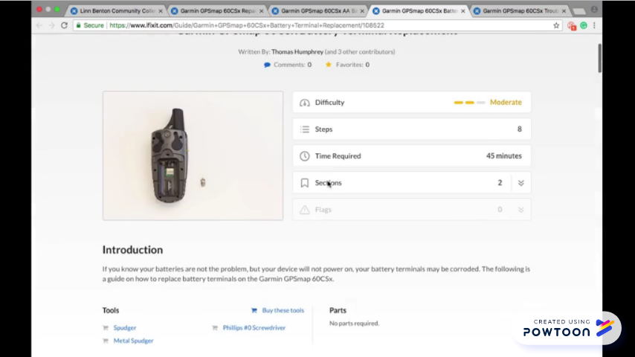
Attribution 4.0 International (CC BY 4.0)

Slide 9
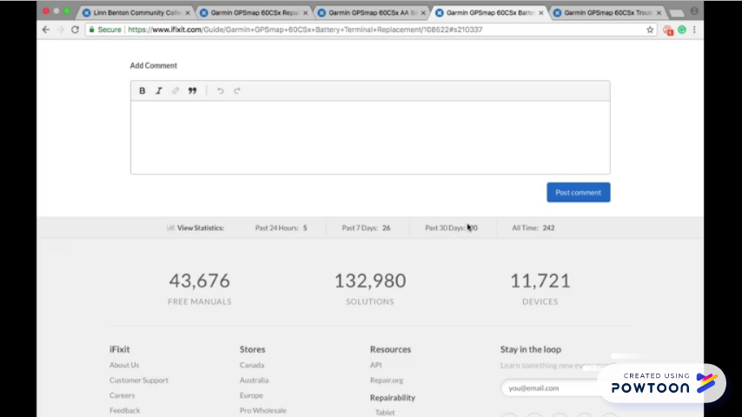
Attribution 4.0 International (CC BY 4.0)

Slide 10
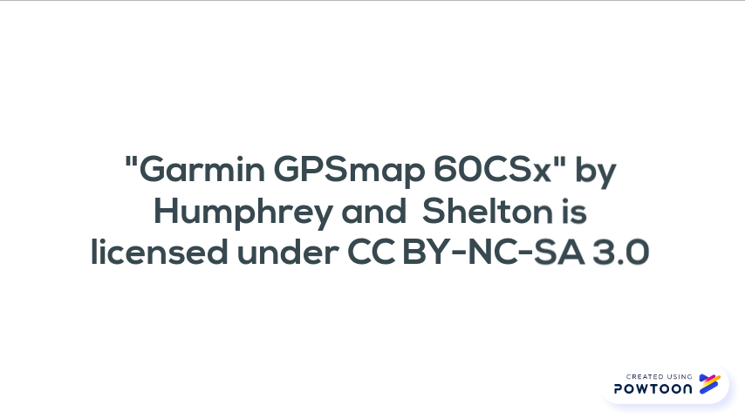
Attribution 4.0 International (CC BY 4.0)

Slide 11

Attribution 4.0 International (CC BY 4.0)

Slide 12

Attribution 4.0 International (CC BY 4.0)

Slide 13

Attribution 4.0 International (CC BY 4.0)

